Slide 1

Chapter 9
Data Analysis, Interpretation, and Presentation

Slide 2
Goals
Discuss the difference between qualitative and quantitative data and analysis
Enable you to analyze data gathered from:
Questionnaires
Interviews
Observation studies
Make you aware of software packages that are available to help your analysis
Identify common pitfalls in data analysis, interpretation, and presentation
Enable you to interpret and present your findings in appropriate ways

Slide 3
Quantitative and qualitative
Quantitative data: Expressed as numbers
Qualitative data: Difficult to measure sensibly as numbers, for example, count number of words to measure dissatisfaction
Quantitative analysis: Numerical methods to ascertain size, magnitude, and amount
Qualitative analysis: Expresses the nature of elements and is represented as themes, patterns, or stories
Be careful how you manipulate data and numbers!

Slide 4
Basic quantitative analysis
Averages:
Mean: Add up values and divide by number of data points
Median: Middle value of data when ranked
Mode: Figure that appears most often in the data
Percentages
Be careful not to mislead with numbers!
Graphical representations give overview of data
4

Slide 5
How question design affects data analysis
Question design affects analysis
Open question: Each answer analyzed separately
Closed question: Analyzed quantitatively
Fixed alternative answers restrict what can be said in findings
4

Slide 6
Basic qualitative analysis
Looking for critical incidents
Helps to focus in on key events
Then analysis can proceed using specific techniques
Identifying themes
Emergent from data, dependent on observation framework if used
Inductive analysis
Categorizing data
Categorization scheme pre-specified
Deductive analysis
In practice, combination of inductive and deductive

Slide 7
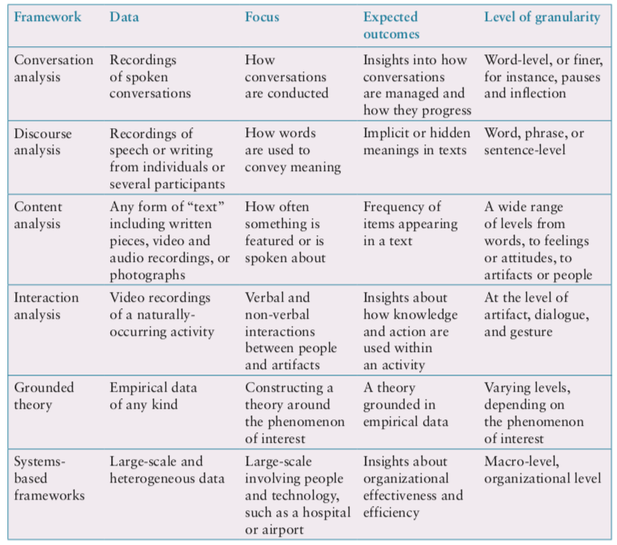
Which analytical framework?

Slide 8
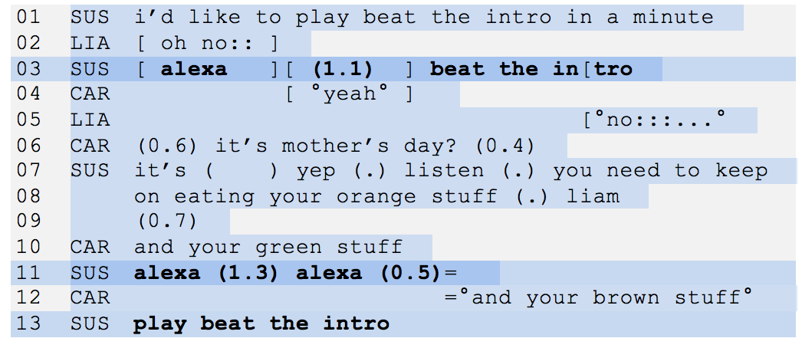
Conversation Analysis
Examines the semantics of a conversation in fine detail
An extract of the conversation between a family and Alexa

Slide 9
Discourse Analysis
Focuses on dialogue; that is, the meaning of what is said and how words convey meaning
Assumption that there is no objective scientific “truth”
Language is viewed as a constructive tool
Discourse analysis is useful when trying to identify subtle meaning

Slide 10
Content Analysis
Involves classifying data into themes or categories and studying their frequencies
Can be used for any “text”: video, newspapers, advertisements, images, and sounds
Often used in conjunction with other techniques

Slide 11
Interaction Analysis
A way to investigate and understand interactions between people and between people and artefacts
Based on empirical observations such as videos
Inductive process in teams, collaboratively
Contents of the material is logged
Materials are extracted, classified, or removed
Instances of a salient event are assembled and played one after the other
The team of researchers studies the assemblage together

Slide 12
Grounded Theory
Seeks to develop theory from systematic analysis of empirical data
Three levels of ‘coding’
Open: Identify categories
Axial: Flesh out and link to subcategories
Selective: Form theoretical scheme
Researchers are encouraged to draw on own theoretical backgrounds to inform analysis
Analytic tools to help stimulate:
Question the data
Analyze words, phrases or sentence
Comparisons between objects or abstract categories

Slide 13
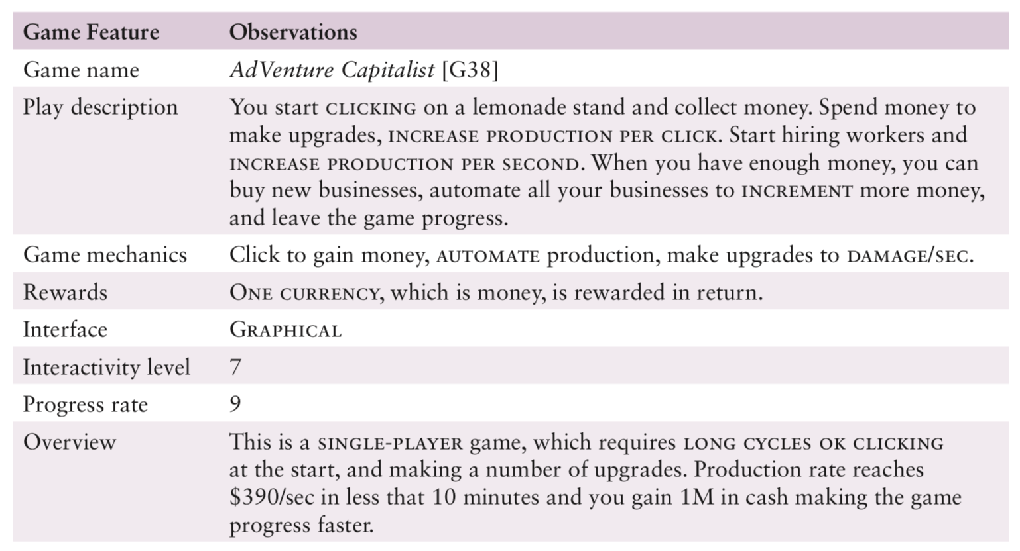
Illustration of open coding

Slide 14
Development of open coding
Source: Alharti et al (2018)

Slide 15
System-based frameworks
Understanding a whole socio-technical system requires different analytical framework
Socio-technical systems theory
Distributed Cognition of Teamwork

Slide 16
Tools to support data analysis
Spreadsheet — Simple to use, basic graphs
Statistical packages, for example, SAS and SPSS
Qualitative data analysis tools
Categorization and theme-based analysis
Quantitative analysis of text-based data
Nvivo and Dedoose support qualitative data analysis
Computer Assisted Qualitative Data Analysis (CAQDAS) Networking Project, based at the University of Surrey

Slide 17
Interpreting and presenting the findings

Slide 18
Interpreting and presenting the findings

Slide 19
Presenting findings
Structured notations have clear syntax and semantics to present particular viewpoint
Stories are easy and intuitive approach to communicate ideas
Summarize findings using a range of notations

Slide 20
Summary
The data analysis that can be done depends on the data gathering that was done
Qualitative and quantitative data may be gathered from any of the three main data gathering approaches
Percentages and averages are commonly used in Interaction Design
Mean, median, and mode are different kinds of ‘average’ and can have very different answers for the same set of data
Analysis of qualitative data analysis may be inductive (extracted from the data), or deductive (pre-existing concepts)
Several analytical frameworks exist that focus on different levels of granularity with different purposes
19

